Slide 1
3 Interpretation
Notes:
Analysis (Scanning)
From book:
CFG, Recursive Descent, AST, (Visitor+checker)
From project:
BoCoLa: Scanner, CFG, Recursive Descent, AST

Slide 2
Interpreters
Recursive interpreter
  Not primitive instructions (subcommands, sub sub commands, …)
Iterative interpreter
  Primitive instructions (HALT, JUMP, MOVE, …)
TAM interpreter
Notes:
Interpreter – program that executes immediately
Iterative interpretation when instructions are executed one after another and it is suitable when source language instructions are primitive (MOVE, HALT, ADD, SUB, JUMP, …)
Recursive interpretation when instructions (commands) are not primitive (subcommand, sub subcommand, …), each not primitive instruction have sub sets of instructions “trees”.
Recursive+iterative interpreters, “tombstones”
Read (8.2, 8.3;C.1-C.3)
- what is the interpretation?
- differences between iterative and recursive
- examples of interpreters used/can be used in our project
- what is the tombstone?
- example of tombstones in our system?
What is TAM interpreter?
TAM interpreter analyzes the entire source program before executes, here it lose main feature of the interpretation – immediacy. Better alternative use a compiler. That is why is not good idea to use recursive interpreter. (it is slow)

Slide 3
Iterative/Recursive Interpretation
init
fetch
fetch
analyze
analyze
execute
execute
There are
still
instructions?
Notes:
Here are two schemes of interpretation. At the left scheme of iterative interpretation and at the right scheme of recursive interpretation.

Slide 4
Iterative interpretation execution
INS1
INS2
INS3
INS n
…
Fetched
Analyzed
Executed
Current
Instruction
INS2
Notes:
Iterative interpretation goes step by step analyzing and executing instructions (INS). First instruction are fetched when analyzed and when executed, loop repeats until there are no instructions.

Slide 5
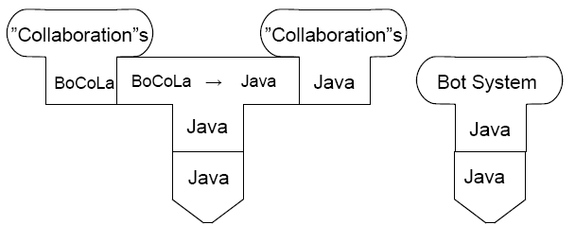
“Tombstones”
Notes:
Here are representation of our system:
BoCoLa source language translated to Java code and Java code used in Java Machine.
Bot System

Slide 6
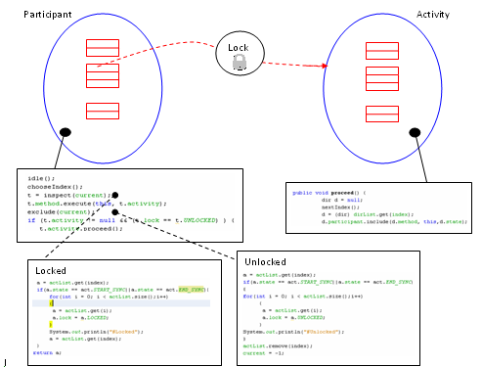
Runtime system
  Runtime system
  BoCoLa runtime system
  Run time organization in a Bots System
Notes:
BoCoLa runtime system (Activity, Participant)
Read ( 5.3;6.4.2,6.7-6.8;7.2)
What is runtime system?
Run time system – software collection created to support execution. It provides services: libraries, subroutines for common operations (code generation, debugging, ...)
Why is it necessary?
Because it relief programmer of writing ordinary code. It provides all necessary simple features.
Why BoCoLa need runtime system?
It supports collaborations between bots.
Run time organization?
Into Activity and Participant class. Participant is a bot which doing some of activity (Move or Work). Participants executed from list.

